Slide 1

Heart Disease Prediction using Machine Learning
COMPUTER SCIENCE AND ENGINEERING
Institute of Engineering and Technology,
Lucknow Dr. A.P.J. Abdul Kalam Technical University, Lucknow, Uttar Pradesh.
Submitted by: -
Satish Shriwas-1805210046
Sudhanshu Singh-1805210056
Shweta-1805210054
Under the guidance of: -
Dr. Pawan Kumar Tiwari
&
Ms. Pratibha Pandey

Slide 2
OUTLINE
Introduction
Motivation
Literature Survey
Feature selection
Methodology
Implementation
Models
Results
Working of portal
References

Slide 3
INTRODUCTION : HEART DISEASE AND SYMPTOMS
The general term used to cover malfunctions or irregularities of the heart is Heart Disease, or sometimes Cardiac Disease.
Although heart disease can occur in different forms, there is a common set of core risk factors that influence whether someone will ultimately be at risk for heart disease or not
.
As further symptoms are considered, they can include:
Chest pain, chest tightness, chest pressure and discomfort in chest (angina).
Shortness of breath even during light activities.
Pain, numbness, weakness or coldness in your legs or arms if the blood vessels in those parts of your body are narrowed.
Infants may experience shortness of breath during feedings, leading to poor weight gain and physical ailments.
Severe Continuous pain in the neck, throat , back of abdomen.
Access adipose tissue, elevated blood pressure levels and elevated cholesterol levels.

Slide 4
INTRODUCTION: ABOUT PROJECT
To obtain reasonable diagnoses and predictions, we have analysed data points using different machine learning models. Health professionals or any individual can now use these trained models for increased risk assessment, recommendations, and for complementary care. With this technology, we can easily filter out a portion of patients and direct resources/attention to those in greater need, as well as identify anyone who is in superb health, without wasting time or resources so that proper attention can be given to those who are actually suffering.
Our aim is:
In order to meet the needs of most different situations, try to cover as many different options under different conditions as possible in a single module.
Try to make the more accurate model ,along with the minimal frontend so that user can interact easily with it.
For Backend:
Data points for prediction will be finalised based on the previous medical research.
We will use various machine learning algorithms to find the correlation between data points and heart condition and the algorithms which gives the most accurate prediction will be chosen.
For Frontend we have created a web application that will make it more accessible for users. User can interact with frontend part which will facilitates data collection.

Slide 5
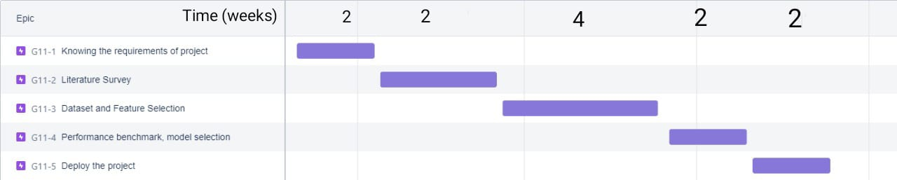
TIMELINE
Gantt Chart for the timeline of project is shown below:

Slide 6
MOTIVATION: FACTS
According to World Health Organization statistics, cardiovascular disease is the leading cause of death in the world. CVDs were responsible for 32% of all global deaths in 2019, as estimated by the World Health Organization. Heart attacks and strokes were responsible for 85% of these deaths. Low- and middle-income countries account for more than three quarters of all CVD deaths.[1]
A survey revealed that the United States is the worst affected country by heart disease where the ratio of heart disease patients is very high [0].It costed about $363 billion for United States of America each year from 2016 to 2017 to treat just heart diseases.
People who are residing in low- and middle-income countries generally do not have the benefit of primary health care programmes neither sufficient medical infrastructure or machines for early detection and treatment of people with risk factors for CVDs or other less detectable disease.

Slide 7
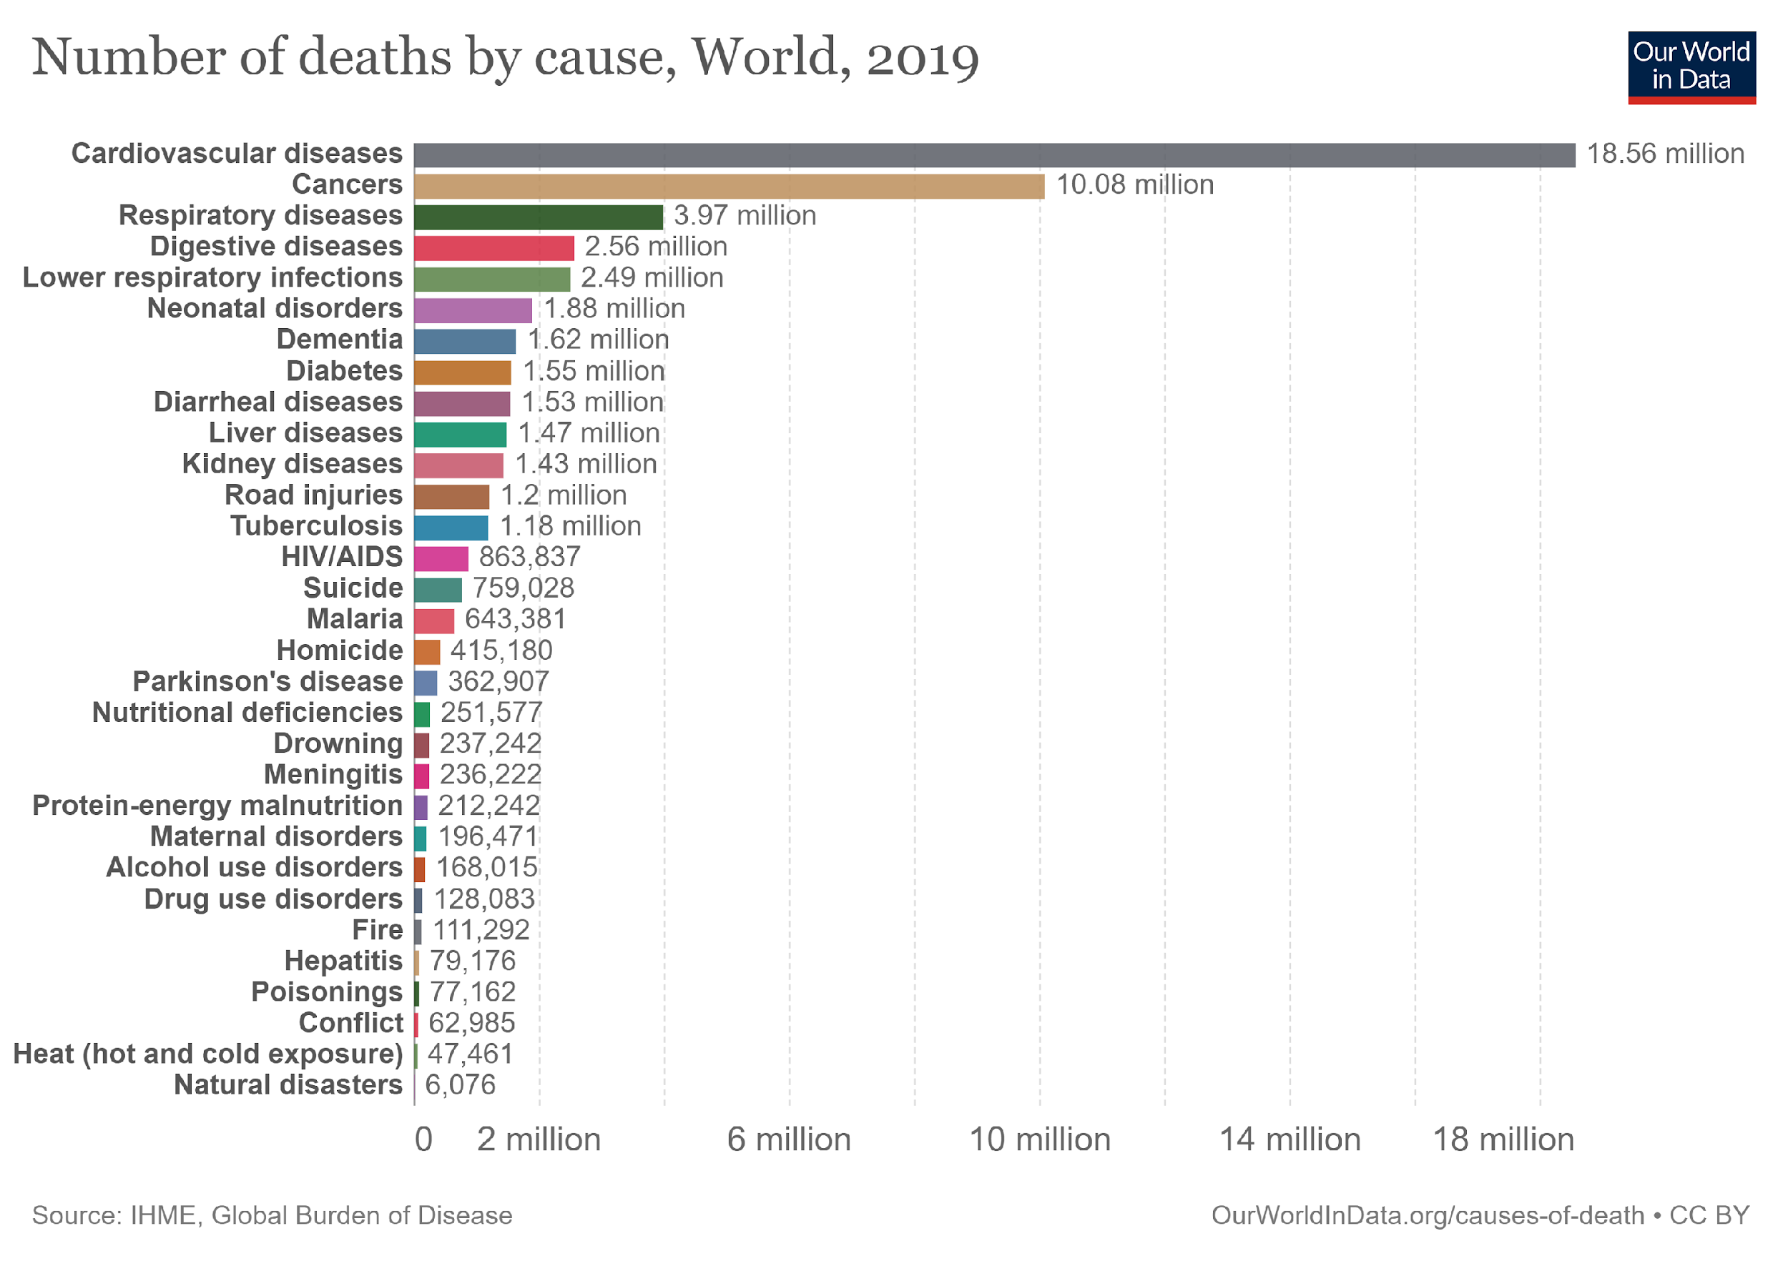
Source: https://ourworldindata.org/grapher/annual-number-of-deaths-by-cause

Slide 8
MOTIVATION
In 2016 Deaths from NCDs accounted for 63 percent of all recorded deaths in India, while 27 percent were linked to CVDs. In the 40-69-year-old age group, cardiovascular disease accounted for 45 percent of deaths.[2]
Healthcare systems are overwhelmed by the covid-19 pandemic. So there’s a huge workload in this pandemic on healthcare system, adversely affecting those under care.
This workload also affects the ability of health professionals( Doctors , Nurses ) to make decisions.
This brought our interest that healthcare system need more maintenance than its normal maintenance of infrastructure and machinery.
This is the stage where Artificial intelligence can help us to detect the disease in by getting the medical information of individual. As now a days it’s very popular and can solve a lots of problem.

Slide 9
LITERATURE SURVEY
Bo Jin, Chao Che et al. (2018) proposed a “Predicting the Risk of Heart Failure With EHR Sequential Data Modelling” model designed by applying neural network. We tend to used one-hot encryption and word vectors to model the diagnosing events and foretold coronary failure events victimization the essential principles of an extended memory network model. [3].
Ashir Javeed, Shijie Zhou et al. (2017) designed “An Intelligent Learning System based on Random Search Algorithm and Optimized Random Forest Model for Improved Heart Disease Detection”. This paper uses random search algorithm (RSA) for factor selection and random forest model for diagnosing the cardiovascular disease. [4]
Early and accurate detection and diagnosis of heart disease using intelligent computational model.
[Yar Muhammad] , MuhammadTahir1 , Maqsood Hayat1,KilTo Chong[5]

Slide 10
LITERATURE SURVEY CONTD.
ALGORITHM | ACCURACY
Decision Tree | 80.40%
Naive Bayes | 86.12%
Neural Network | 85.68%
4. Same Heart Disease Different ML Models An expert medical diagnosis system was developed using Decision Tree , Naive Bayes and Neural Network by Palaniappan and Awang.[7]
5. Different Disease and Different ML Models:According to Afifa Akhtar, Susmita Roy Tithi and Fahimul Aleem in a study, a specific model provides the most accurate results for a specific type of heart disease.[6]
Based on the data available, there is variation in prediction accuracy. Less Data Less Accuracy
Different Feature contributes differently
These are solved using Feature Selection Algorithms.
Disease Name | Best Algorithm | Score
CAD | Naive Bayes | 94%
Sinus Bradycardia | Decision Tree | 95%
Sinus Tachycardia | All except NN | 95%
Myocardial Infarction | Decision Tree | 96%
Right Bundle Branch Block | Logistic Regression | 96%

Slide 11
FEATURE SELECTION
Age:The probability of heart related issue after 60 years of age is very high, so it's important to include age in the heart disease prediction model.Over 80% of heart disease deaths occur in people over the age of 65, according to empirical estimates.
Sex: Cardiovascular risk factors are more pronounced in women with clinically manifest heart disease than in men.Females are more likely than males to have their first AMI after smoking.
Resting Blood Pressure : (trestbps, Integer, in mmHg)An increased resting heart rate was related to heart disease in both sexes in an annotated study, even after controlling for confounders such as abdominal obesity and general obesity.Resting blood pressure is one of several factors contributing to the risk of heart disease, so it is important to control it.
Angina : Induced during exercise (exang, 0 : no : yes) Reduced blood flow to the heart causes this type of chest pain.The condition is associated with coronary artery disease.Angina pectoris is another name for the symptom.Pain in the chest is commonly described as being squeezing, heavy, or tight.
Highest ST-segment (slope, 1: upward slope, 2: flat, 3: downward slope

Slide 12
FEATURE SELECTION
Resting ECG (aberration in ST/T-wave): Your heart is affected when the electrical impulses produced by other muscles interfere with the heart's electrical impulses.Heart disease patients' ECGs are characterized by naturalness, making them a good indicator to detect the disease.
Classification of Chest-pain:
(cp, Integer, myocardial infarction: {1(typical), 2(atypical)} 3: pain, 4: asymptotic) Shown to be closely related to heart related risk factors
Fasting Blood Sugar (fbs, Integer, 1: if fasting blood sugar over 120mg/dl, 0: otherwise)Heart related disease risks and fasting glucose levels tend to follow J shape curves.A glucose level of 85 to 99 mg/dL carries the lowest risk.The risk of heart disease, ischemic heart disease, myocardial infarction, and thrombotic stroke increased progressively when fasting glucose levels reached more than 110 mg/dL, but not the risk of hemorrhagic stroke.A fasting glucose level below 70 mg per dL was associated with increased stroke risk in 15 of 17 patients (hazard ratio 1.0, 95% CI 1.01-1.11) in men, and 1.10, 1.05-1.18 for women.
Flourosopy colored vessels (ca, Integer, 0,1,2,3).

Slide 13
FEATURE SELECTION
◼ Serum Cholesterol (chol, Integer, in mg/dl) A correlation between serum cholesterol level and coronary heart disease was found to range from 1.3 (95% CI 0.7-2.3) in those with a level between 4.7 and 5.1.However, the difference was less for those with 6.2 mmol/L or more (95 % CI 1.0, 2.7), compared to those who had 4.7 mmol/L or less.In contrast, more active individuals did not experience this.Individuals who participated in lesser physical activity had significantly inverse relative risks for all levels of cholesterol, including cholesterol levels exceeding 6.2 mmol/L (Relative risk = 0.4) (95% CI 0.2, 0.7).
◼ Thalassemia (thal, Integer, defect: {6(non-fixable), 7(reversible)}, otherwise: 3)Your body has less hemoglobin than normal as a result of this inherited blood disorder.Basically, hemoglobin carries oxygen.If you have thalassemia, you will feel fatigued.
◼ Max heart rate achieved (thalach, Integer)Despite controlling for age in the study, the maximum heart rate is correlated with heart failure in the annotated study.Likewise, max heart rate, negatively correlated with access adipose tissue, is an indicator of fitness.So it is a good tool, presumably associated with an inverse relationship between heart disease risk and exercise.
◼ Exercise induced ST depression (oldpeak, Integer)In an ECG, exercise-induced ST segment depression is defined as a horizontal or downsloping ST depression greater than 1.0 mm at 80 ms after the J point or any ST depression of greater than 1.0 mm.

Slide 14
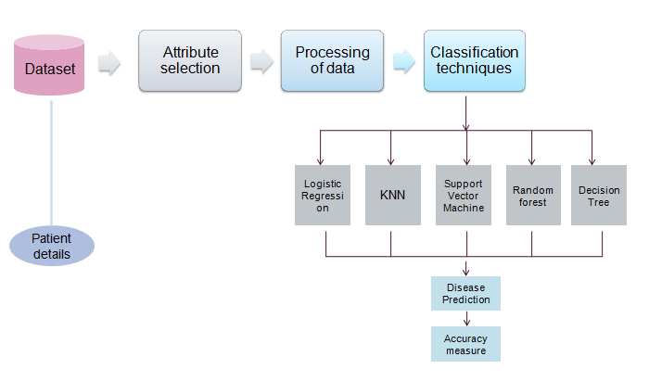
METHODOLOGY
Accuracies- 85% 75% 83% 93% 91%

Slide 15
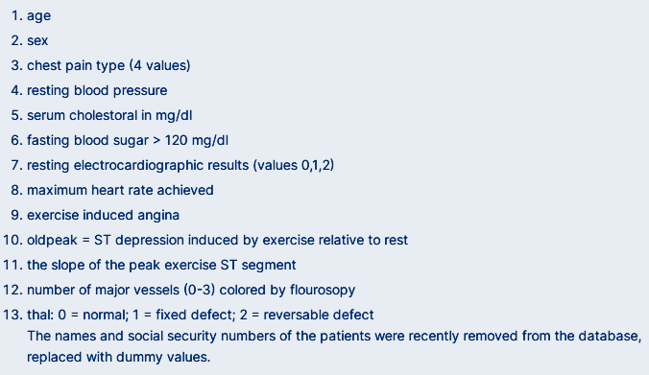
IMPLEMENTATION
The dataset contains four databases dating from 1988- Cleveland , Hungary , Switzerland , and Long Beach V . There are 76 attributes including the predicted attribute, but published studies only utilize 1 of them . This field indicates whether a patient has heart disease or not. The values are 0 for no disease and 1 for disease.

Slide 16
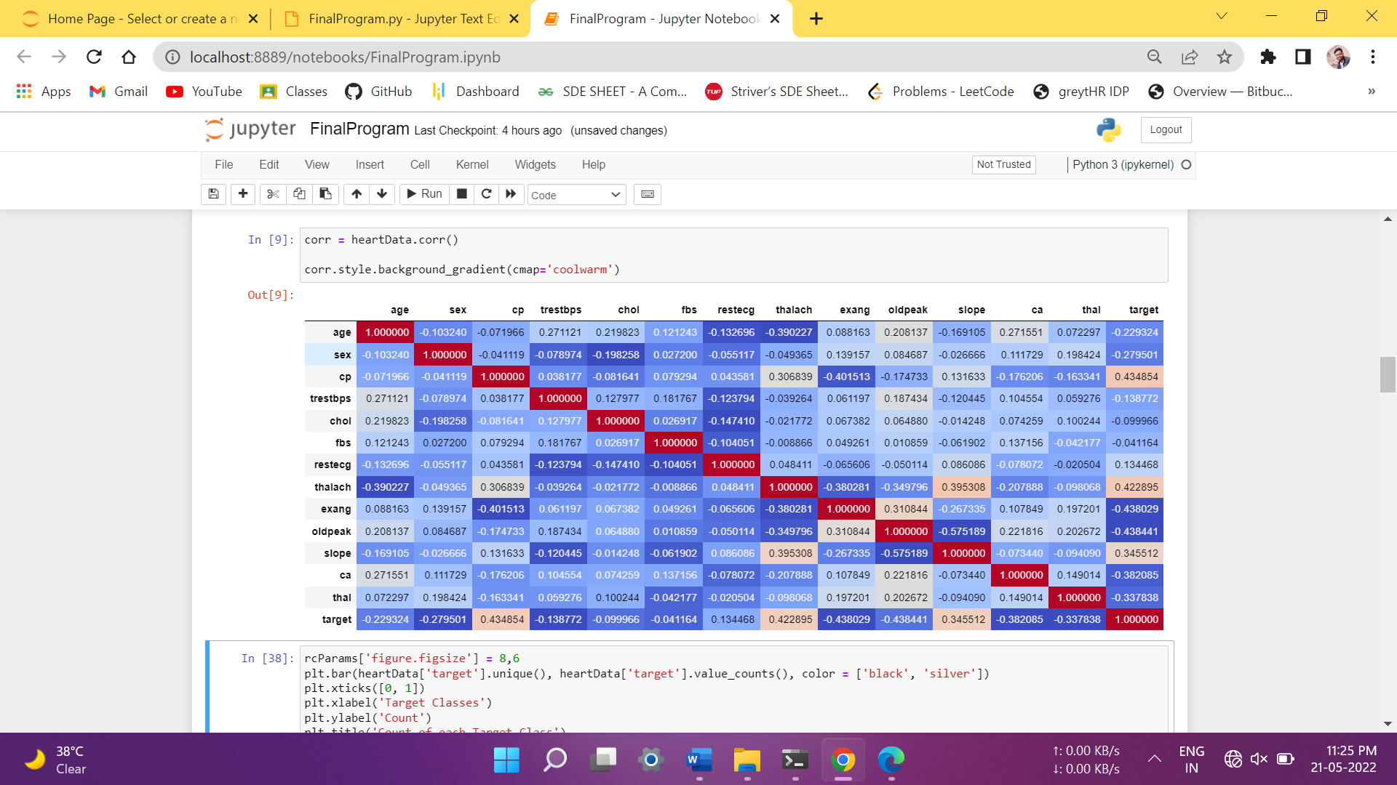
Correlation Matrix
We will generate and understand correlation between our attributes and target class. Correlation matrix will be generated and plotted using matplotlib.
For a correlation matrix, more positive the value of correlation, the more increase in value of one variable cause the other to increase i.e. more directly proportional. The higher a negatively correlated variables gets, the lower the value of the target becomes.

Slide 17
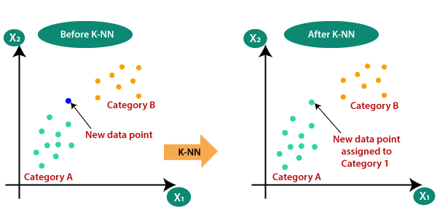
K-Nearest Neighbors
By using soma metrics (e.g. Euclidean distance, Manhattan distance, etc. ), the K-NN algorithm ranks k nearest data points based on their distance from the input.It classifies inputs according to the majority vote of neighbouring categories.This model does not require training, but requires heavy computation during classification.

Slide 18
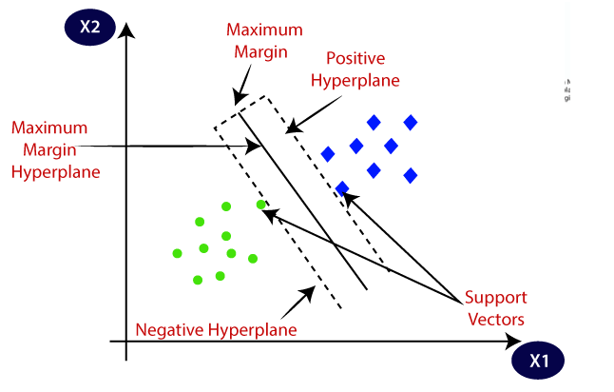
Support Vector Machine
It is useful in solving both classification and regression problems. It makes sure that they are easily separable by creating marginal distance by drawing parallel lines to hyperplane passing through one of the nearest point.
Our aim is to maximize marginal distances.
Support Vectors- They are the points that is actually passing through the marginal plane that we created parallel to the hyperplane. It may be multiple points.

Slide 19
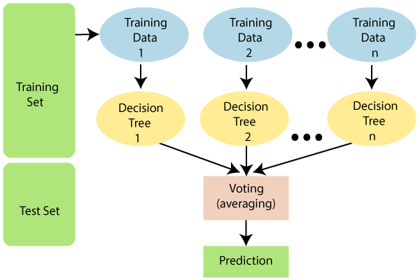
Random Forest
47.6M
1K
OOPs Concepts in Java
Supervised machine learning algorithms, such as random forests, are widely used for classification and regression problems.In regression, it takes the average of the majority votes for classification and their majority votes for classification.
A forest with more trees will result in greater accuracy, thereby preventing overfitting.

Slide 20
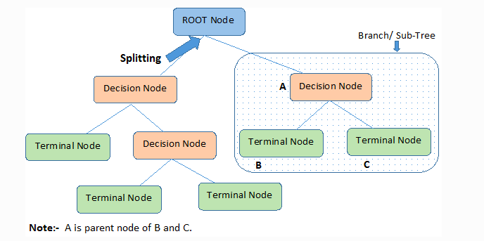
Decision Tree
Several algorithms are used to decide whether a node should be split into two or more sub-nodes in a decision tree . As a result of creating sub-nodes, there is a higher homogeneity that results . Alternatively, we can say that as the target value increases , the node's purity increases.
In decision tree internal nodes represents the test done and the branches represent decisions of those tests and leaf nodes depicts the outcomes of the tests. And the top most node is called root node. It divides big problem into small sub-problems for our ease.

Slide 21

Logistic Regression
The logit model is one of the most common types of statistical models used for classification and predictive analysis.Using a given dataset of independent variables, logistic regression estimates the chance of an event occurring.Due to the probability nature of the outcome, the dependent variable is bound between 0 and 1.The odds of success divided by the odds of failure are transformed using the logit transformation in logistic regression.A logistic function can also be represented using the following formulas: This is commonly referred to as the log odds, or the natural logarithm of odds.
Logit(pi) = 1/(1+ exp(-pi))
ln(pi/(1-pi)) = Beta_0 + Beta_1*X_1 + … + B_k*K_k

Slide 22
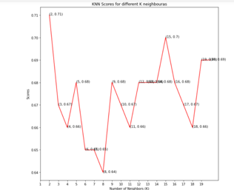
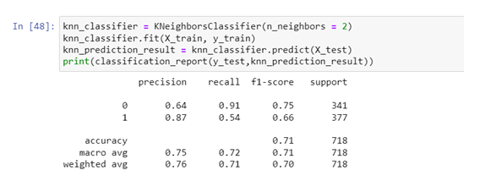
RESULTS
K- nearest Neighbors
Accuracy-75%

Slide 23
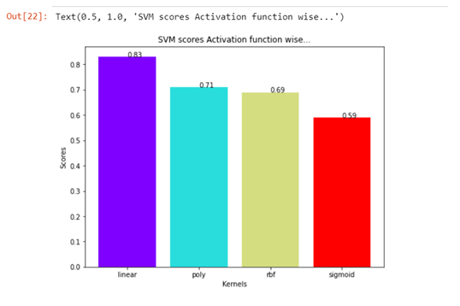
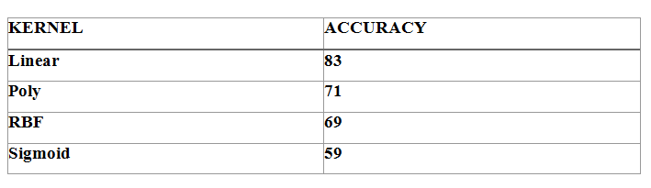
Support Vector Machine

Slide 24
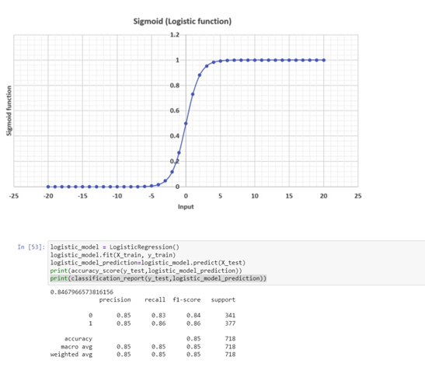
Logistic Regression
Accuracy-85%

Slide 25
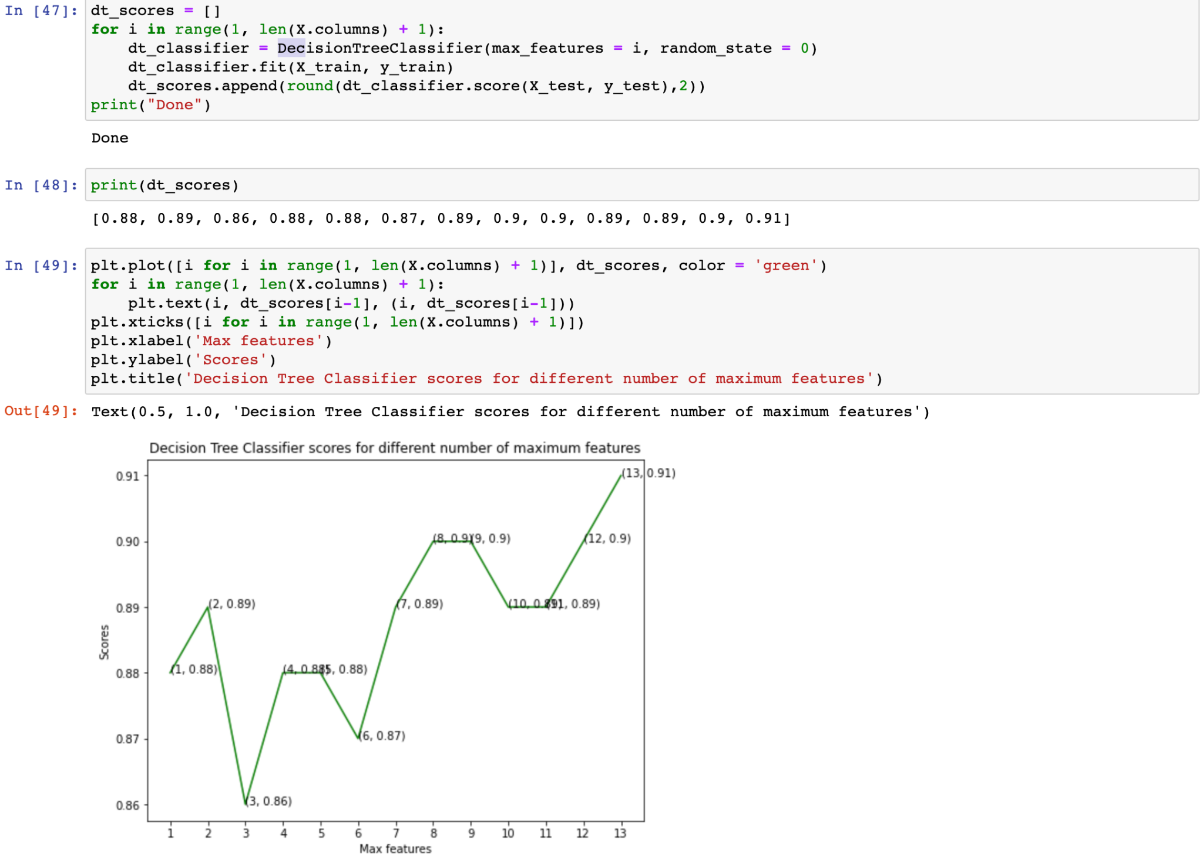
Decision Tree
Decision Tree Result image

Slide 26
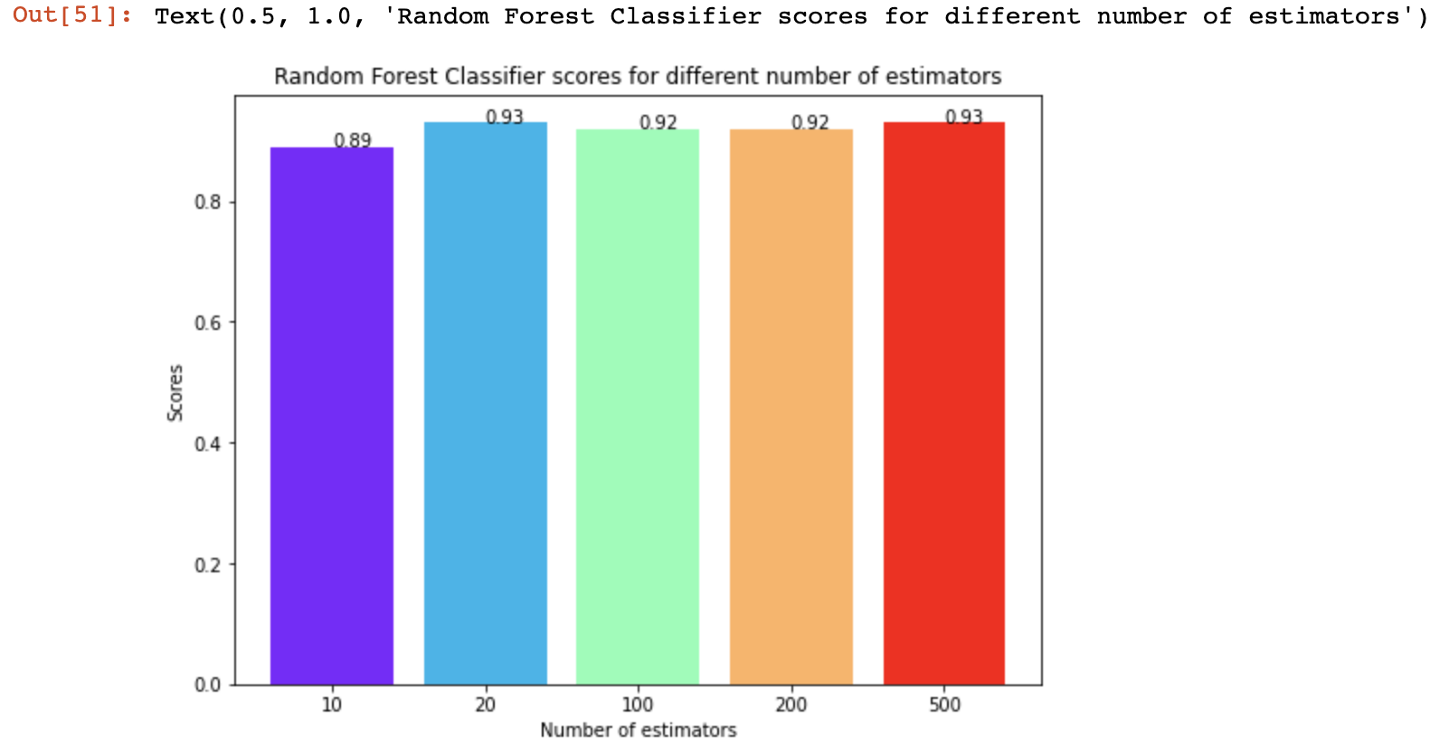
Random Forest
Accuracy-93%
Random Forest result image

Slide 27
WORKING OF PORTAL
PREDICTION MODEL
FORM
ML MODELS
User enter the data
Features of the Portal-
User friendly website.
Will show your full report with the level of risk of heart disease.
Comparative Analysis.
Future Scope-
Future work for this project can be included as deploying after modifying the parameters.
Models can also be trained with reduced parameters .One can increase the accuracy if possible, as there is always a chance of improvement
One can also use other classification algorithms with reduced parameters so that in case of absence of some attributes, users will be able to check ,however with reduced accuracy.
DATA GOES TO BACKEND
PREDICT
RETURNS PREDICTION RESULTS
RESULT

Slide 28
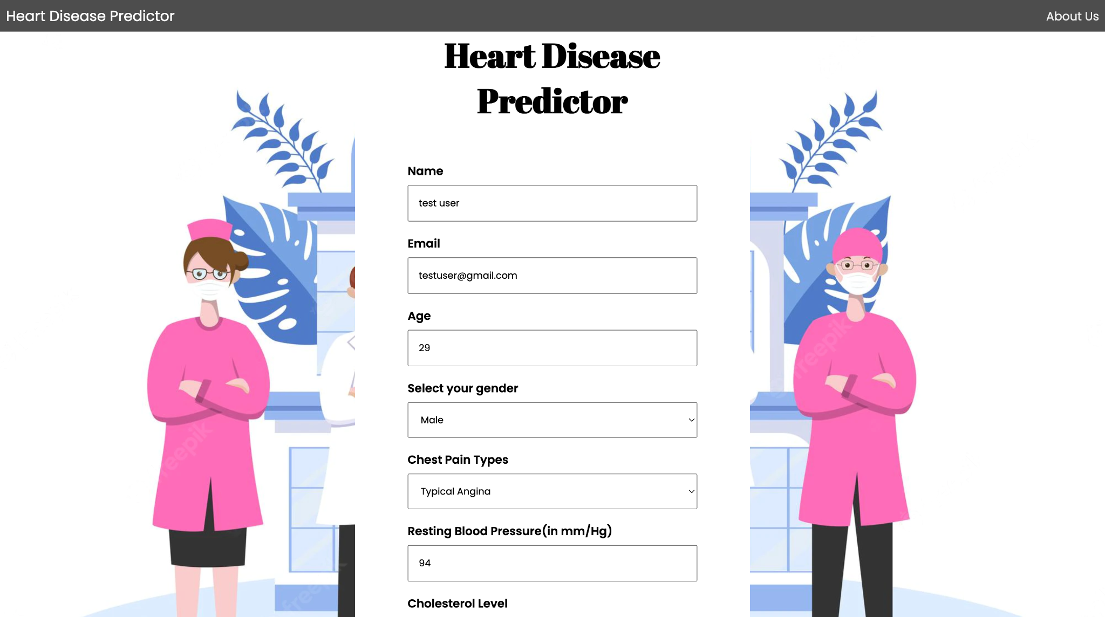
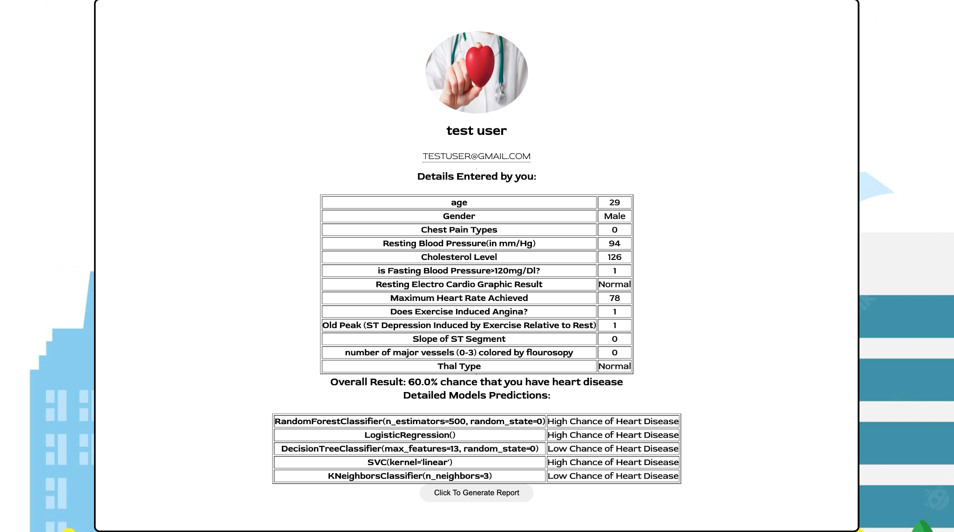
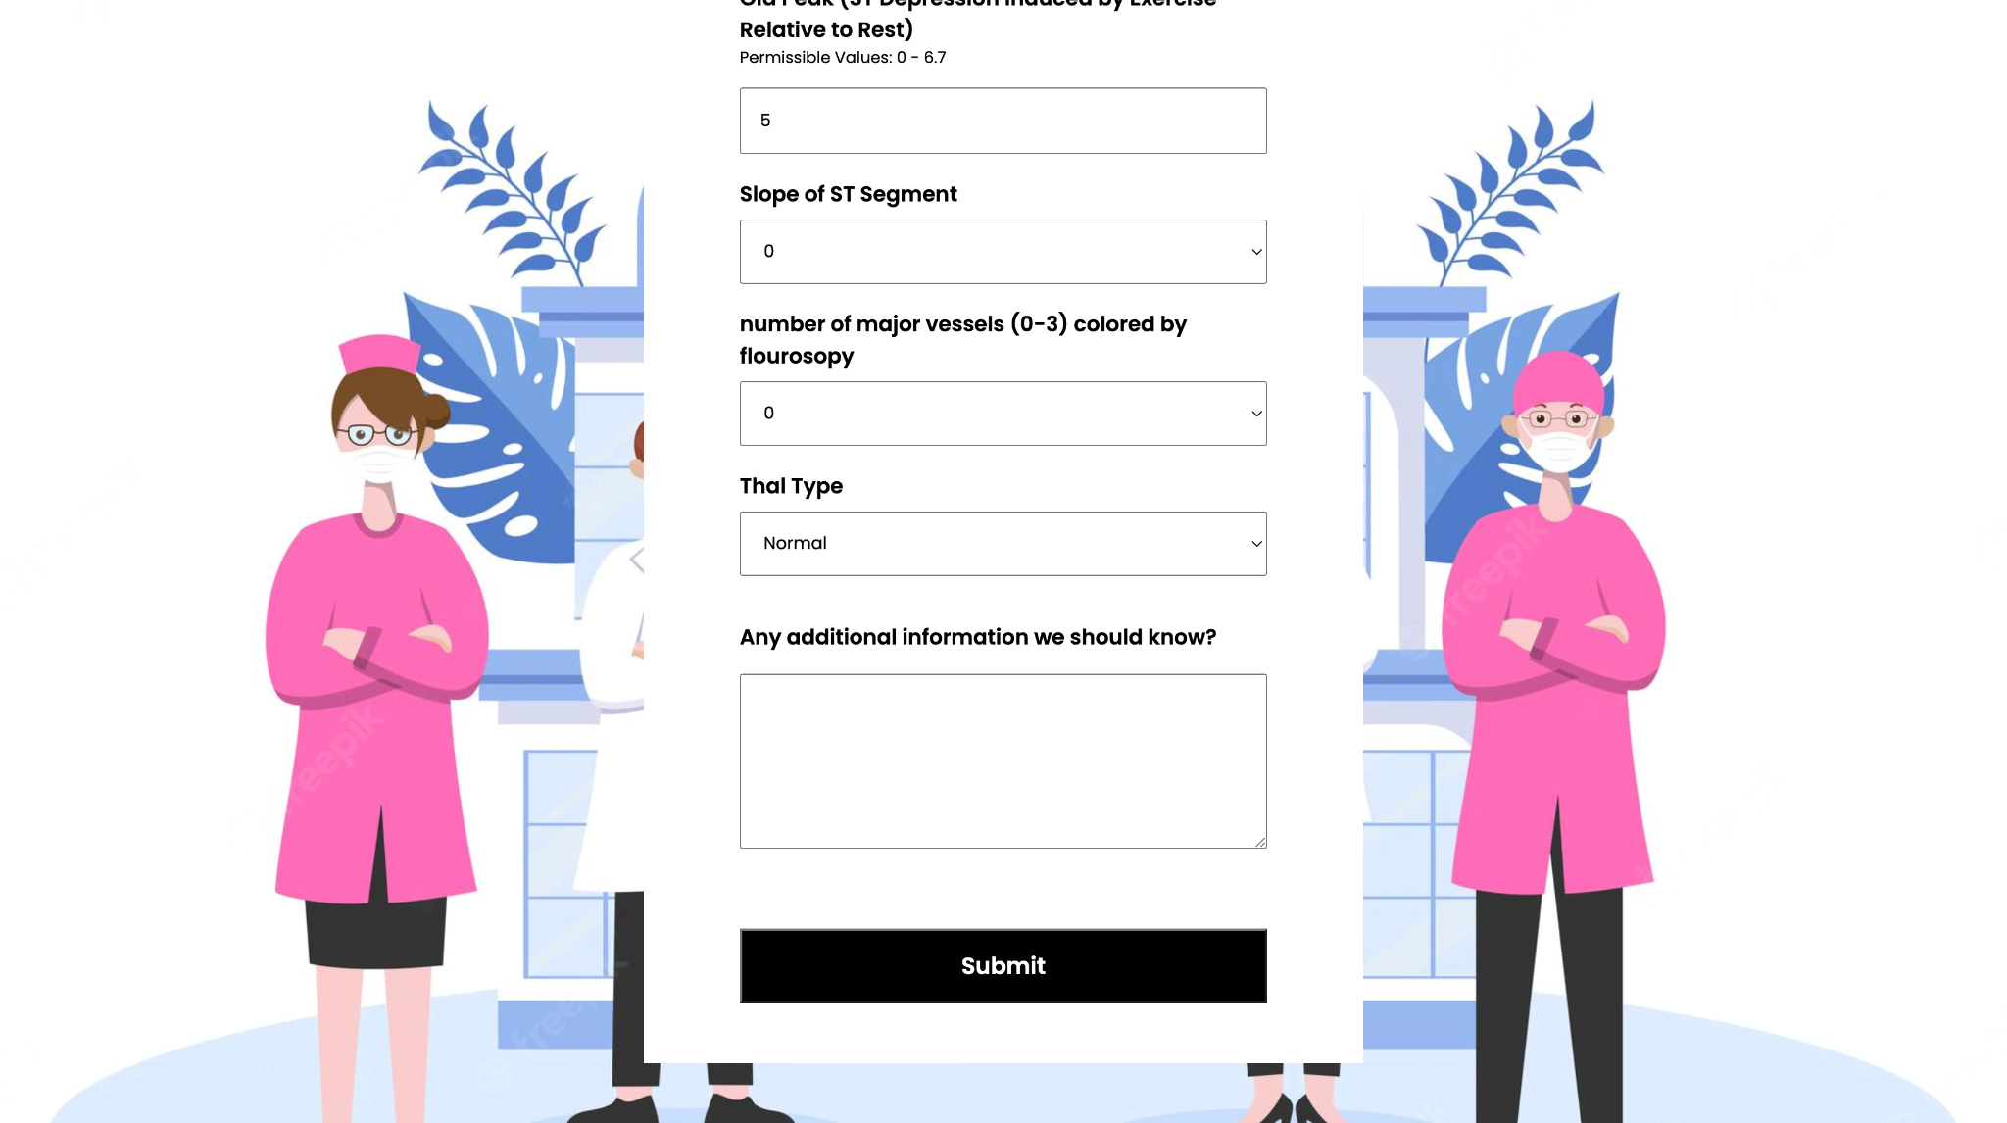
PORTAL PREVIEW
Result Page
Input Form

Slide 29
REFERENCES
[0] https://www.cdc.gov/heartdisease/facts.htm
[1]https://www.who.int/news-room/fact-sheets/detail/cardiovascular-diseases-(cvds)#:~:text=Cardiovascular%20diseases%20(CVDs)%20are%20the,%2D%20and%20middle%2Dincome%20countries.
[2]https://www.who.int/india/health-topics/cardiovascular-diseases#:~:text=In%202016%20India%20reported%2063,well%20as%20overweight%20and%20obesity.
[3] Bo Jin ,Chao Che, Zhen Liu, Shulong Zhang, Xiaomeng Yin,And Xiaopeng Wei, “Predicting the Risk of Heart Failure WithEHR Sequential Data Modeling” ,IEEE Access 2018.
[4] Ashir Javeed, Shijie Zhou, Liao Yongjian, Iqbal Qasim,Adeeb Noor, Redhwan Nour4, Samad Wali And Abdul Basit ,“An Intelligent Learning System based on Random SearchAlgorithm and Optimized Random Forest Model forImproved Heart Disease Detection” , IEEE Access 2017.
[5] Yar Muhammad, Muhammad Tahir, Maqsood Hayat & Kil To Chong Early and accurate detection and diagnosis of heart disease using intelligent computational model.[https://www.nature.com/articles/s41598-020-76635-9]
[6] Sushmita Roy Tithi , Aﬁfa Aktar , Fahimul Aleem , Amitabha Chakrabarty ‘’ECG data analysis and heart disease prediction using machine learning algorithms’’. Proceedings of 2019 IEEE Region 10 Symposium.
[7] Sellappan Palaniappan , Rafiah Awang “Intelligent Heart Disease Prediction System Using Data Mining Techniques ” IJCSNS International Journal of Computer Science and Network Security, VOL.8 No.8, August 2008

Slide 30
THANK YOU 🖋
THANK YOU

